Slide 1
Can Stock Market Forecasters Forecast?
Author: Alfred Cowles 3rd
Presenter: Yichen Wang

Slide 2
Introduction
This paper was read before a joint meeting of the Econometric Society and the American Statistical Association in Cincinnati, Ohio on December 31, 1932.
Analyzed the forecasting efforts of 45 professional agencies on specific stocks or the stock market itself.
Part I: Attempts of two groups, 16 financial services and 20 fire insurance companies, to predict which specific securities would prove most profitable.
Part II: Efforts of 25 publications to predict the future course of the stock market.

Slide 3
Forecasting Individual Stock Prices – Group I
Analyzed on records over 4.5 years ending July, 1932, of 16 leading financial services with regularly updated lists of common stocks to their subscribers for investment.
The analysis includes 7,500 separate recommendations.
Methodology: Record each week the name and price of each stock recommended for purchase or sale by each service. Tabulate the advice to sell or cover the commitment previously advised.
Assumptions: Reiterated advice was not considered.

Slide 4
Group I - Methodologies
Record each week the name and price of each stock recommended for purchase or sale by each service.
Tabulate the advice to sell or cover the commitment previously advised without iterated advise.
Record percentage gain or loss on each transaction and the gain or loss of the stock market for the identical period in a parallel column every six months.
Proper corrections were made to offset the effect of changes in capital structure resulting from the issue of rights, stock dividends, etc.
Automatically drop a stock from the list six months after it had been last recommended, when specific advice to sell was not given.
A redistribution of funds in equal amounts among all stocks recommended has been assumed for each service at the beginning of every six months’ period analyzed.

Slide 5
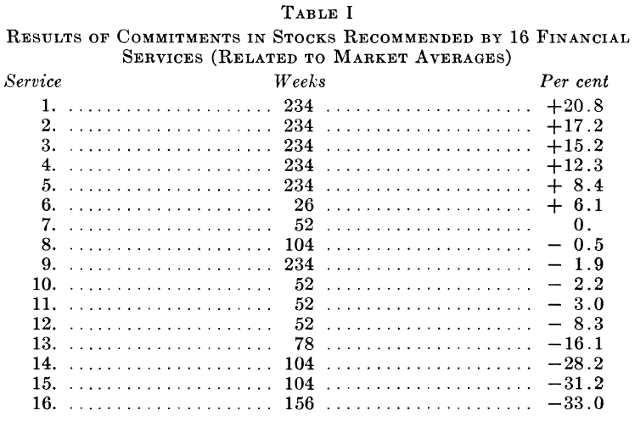
Group I - Results
Only 6 of the 16 services achieved any success.
The average effective annual rate of all the services is -1.43%.

Slide 6
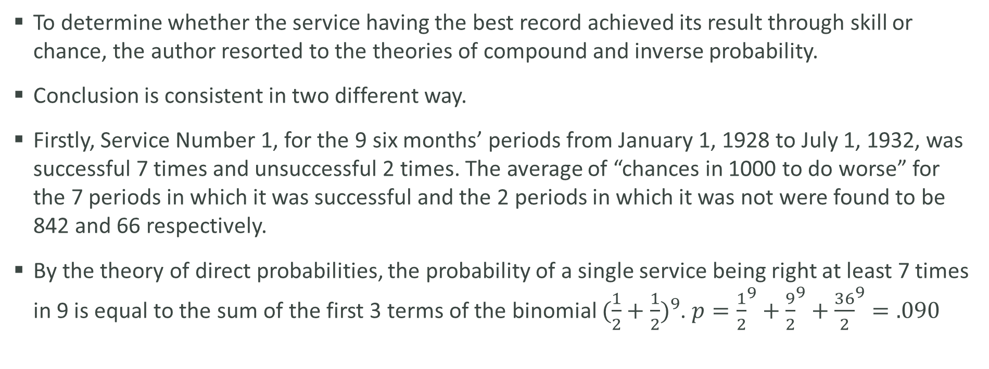
Group I – Probability Tests
To determine whether the service having the best record achieved its result through skill or chance, the author resorted to the theories of compound and inverse probability.
Conclusion is consistent in two different way.
Firstly, Service Number 1, for the 9 six months’ periods from January 1, 1928 to July 1, 1932, was successful 7 times and unsuccessful 2 times. The average of “chances in 1000 to do worse” for the 7 periods in which it was successful and the 2 periods in which it was not were found to be 842 and 66 respectively.
By the theory of direct probabilities, the probability of a single service being right at least 7 times in 9 is equal to the sum of the first 3 terms of the binomial ${(\frac{1}{2}+\frac{1}{2})}^{9}$. $p={\frac{1}{2}}^{9}+{\frac{9}{2}}^{9}+{\frac{36}{2}}^{9}=.090$

Slide 7
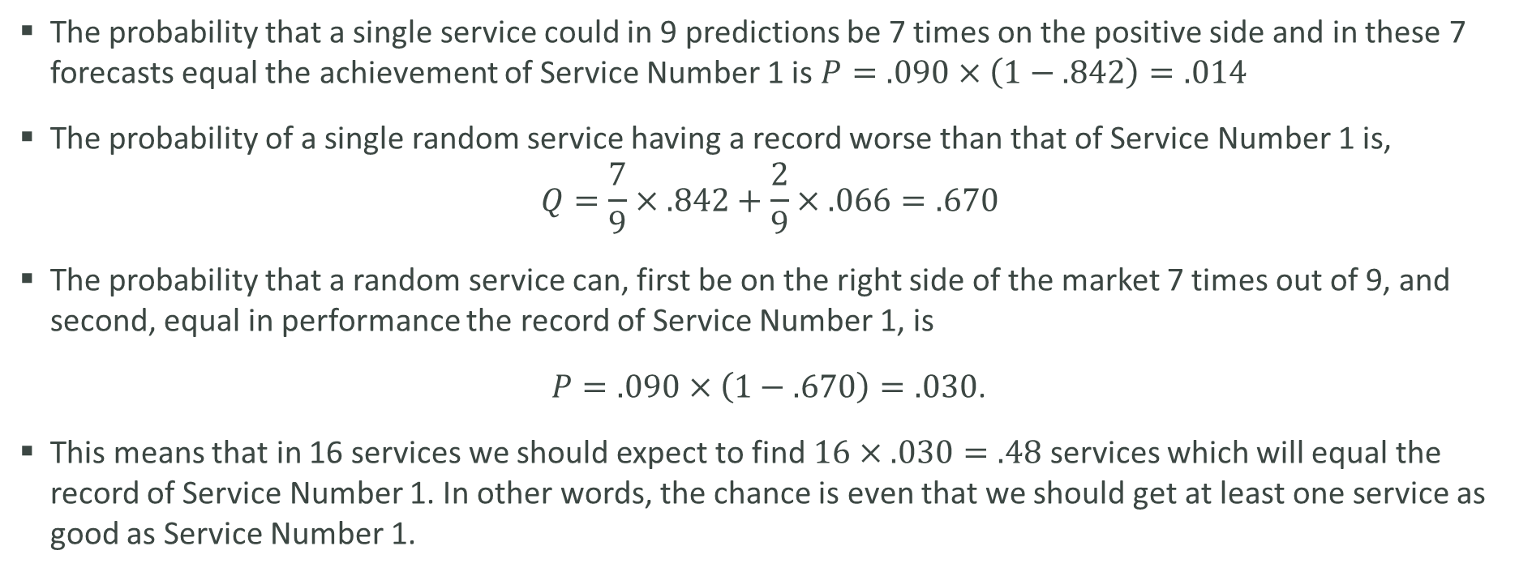
Group I – Probability Tests (cont’d)
The probability that a single service could in 9 predictions be 7 times on the positive side and in these 7 forecasts equal the achievement of Service Number 1 is $P=.090×\left(1−.842\right)=.014$
The probability of a single random service having a record worse than that of Service Number 1 is,
$$Q=\frac{7}{9}×.842+\frac{2}{9}×.066=.670$$
The probability that a random service can, first be on the right side of the market 7 times out of 9, and second, equal in performance the record of Service Number 1, is
$P=.090×\left(1−.670\right)=.030$.
This means that in 16 services we should expect to find $16×.030=.48$ services which will equal the record of Service Number 1. In other words, the chance is even that we should get at least one service as good as Service Number 1.

Slide 8
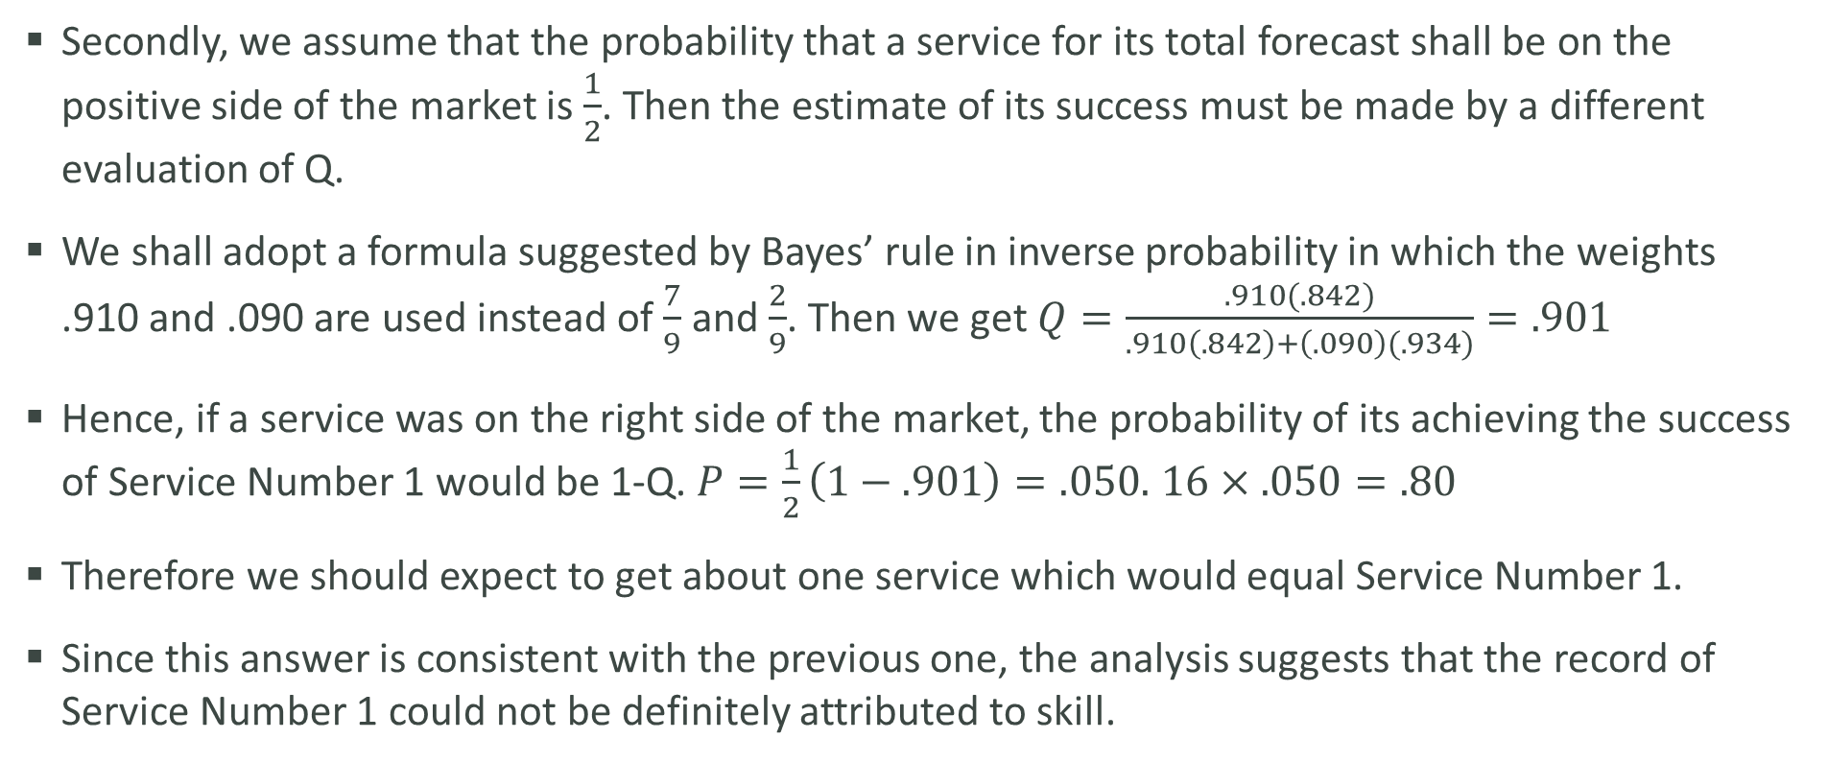
Group I – Probability Tests (cont’d)
Secondly, we assume that the probability that a service for its total forecast shall be on the positive side of the market is $\frac{1}{2}$. Then the estimate of its success must be made by a different evaluation of Q.
We shall adopt a formula suggested by Bayes’ rule in inverse probability in which the weights .910 and .090 are used instead of $\frac{7}{9}$ and $\frac{2}{9}$. Then we get $Q=\frac{.910(.842)}{.910\left(.842\right)+\left(.090\right)(.934)}=.901$
Hence, if a service was on the right side of the market, the probability of its achieving the success of Service Number 1 would be 1-Q. $P=\frac{1}{2}\left(1−.901\right)=.050.$ $16×.050=.80$
Therefore we should expect to get about one service which would equal Service Number 1.
Since this answer is consistent with the previous one, the analysis suggests that the record of Service Number 1 could not be definitely attributed to skill.

Slide 9
Forecasting Individual Stock Prices – Group II
Analyzed on common stock investments, from 1928 to 1931 inclusive, of 20 leading fire insurance companies.
These companies are representative of a class of common stock investor which has long years of experience and large amount of capital at its disposal.
The 20 companies selected hold assets totaling several hundred million dollars.
They carry between 20% and 30% of their total investments in common stocks and their average turnover amounts to only 5% a year.
All stocks purchased are given equal weights.
Method is essentially same as that used in previous example.

Slide 10
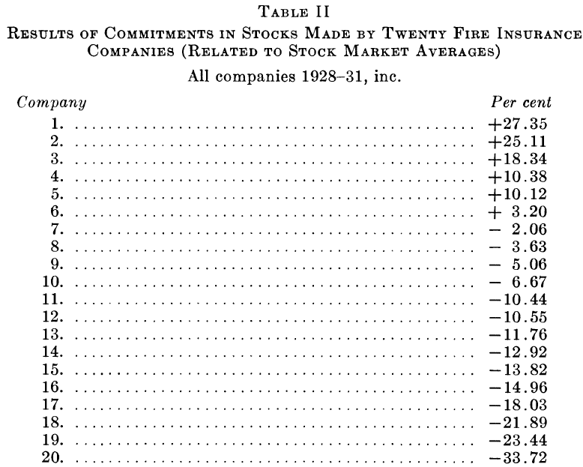
Group II – Results
Six of the companies show evidence of success, and the average of the 20 is -4.72%.
The average record of the companies in the stocks they selected for investment fell below the average of the stock market at the effective annual rate of 1.20%.
A comparable result could have been achieved through a purely random selection of stocks.
The analysis confirmed the results in previous example of financial services.

Slide 11
Forecasting The Stock Market – William Peter Hamilton
William Peter Hamilton was the editor of the Wall Street Journal from 1902 to 1929.
During 26 years of his incumbency he wrote 255 editorials which presented forecasts for the stock market based on the Dow Theory which was the creation of Charles H. Dow.
These were sufficiently definite to permit scoring as bullish, bearish, or doubtful.
  Doubtful: Assume he abstained from trading.
  Bullish: Assume he bought equal dollar amounts of stocks included in the Dow Jones railroad and industrial averages, and sold them only when he became bearish or doubtful.
  Bearish: Assume he sold short equal dollar amounts of these stocks and covered only when he became doubtful and bullish.
The percentage gain or loss on each transaction has been calculated and the results compounded through the 26 years.

Slide 12
William Peter Hamilton – Results
From December 1903 to December 1929, Hamilton would have earned a return, including dividend and interest income, of 12% per year.
In the same period, the stocks composing the industrial averages showed a return of 15.5% per year.
However, he exceeded a supposedly normal investment return of 5%.
Applying his forecasts to the stocks composing the Dow Jones railroad averages, the annual gain is 5.7% while the railroad averages themselves show a return of 7.7%.

Slide 13
William Peter Hamilton – Results (cont’d)
Hamilton was long of stocks 55%, short 16%, and out of market 29% during 26 years.
Counting only changes of position, he made bullish forecasts 29 times. Applying to industrial averages, 16 were profitable and 13 unprofitable.
Made bearish forecasts 23 times. 10 were profitable and 13 unprofitable.
Advised 38 times that funds be withdrawn from the stock market. 19 were profitable and 19 unprofitable.
In total, 45 of his changes of position were successful, 45 unsuccessful.
During the period from 1909 to 1914, when the industrial averages displayed a horizontal trend, his hypothetical fund shrank 7.8% per year below what it would have been if loaned at 5% interest.

Slide 14
Forecasting The Stock Market – 24 Financial Publications
Selected during the period from January 1, 1928 to June 1, 1932, 24 publications (18 professional financial services, 4 financial weeklies, one bank letter, and one investment house letter). More than 3,300 forecasts were tabulated.
Asked 3 readers of competent intelligence to decide the proportion of their funds (100%, 87.5%, 75%, …, 12.5%, 0%) they would place in the market.
Assumed that there is no marginal commitments and short commitments.
The forecasts have been tested by the actual fluctuations of the stock market as reflected by the Standard Statistics company index of 90 representative stocks.
If a forecast is 100% bullish and the market rises 10%, the forecaster is scored as +10%. If the forecaster leaves the decision hanging in the balance, the score is +5%. If the forecast is 100% bearish, the score is 0.

Slide 15
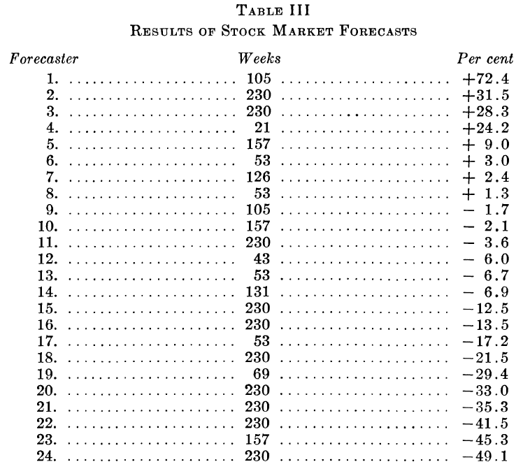
24 Financial Publications – Results
Only one-third of the list met with any success.
The average forecasting agency fell approximately 4% below a record representing the average of all performance achievable by chance.

Slide 16
24 Financial Publications – Results (cont’d)
During the 4.5 years, the number of weeks in which the stock market declined almost exactly equaled the number of weeks in which advances were recorded.
However, during this period, 2035 bullish, 804 bearish, and 479 doubtful forecasts were recorded.
In 1928, the only year the market showed a net gain, the excess of bullish over bearish forecasts was smaller than in any succeeding year.
In 1931, when the market declined 54%, there were sixteen bullish forecasts to every three bearish (only 4 to 3 in 1928).

Slide 17
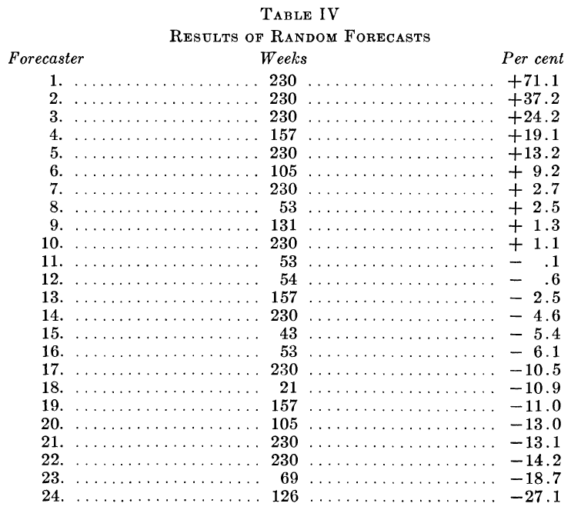
24 Financial Publications – Statistical Interpretations
To determine whether the records of all these forecasters lay within the limits of pure chance, 24 records were compiled during same period, but random advices were applied to random intervals within these periods.

Slide 18
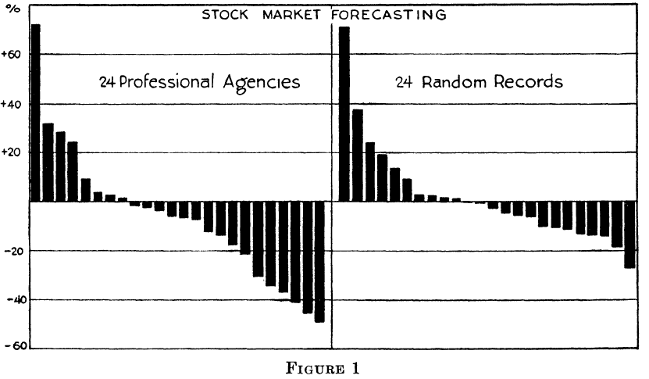
24 Financial Publications – Statistical Interpretations (cont’d)
The largest gains a forecasting agency made lay within the limit equaled by the best of 24 random cases.
However, the extremer losses of the forecasters tended to exceed the losses by the least successful of 24 random operations.

Slide 19
24 Financial Publications – Statistical Interpretations (cont’d)
Record of Forecaster Number 1 was omitted in the statistical interpretation, as its record was available for only 2 years and it did not once change its advice.
Therefore, for the correlation test, Forecasters Number 2, 3, 22 and 24 were chosen to represent the best and the worst whose records covered the entire period under analysis.
The weekly forecasts of each of these four were correlated with the first differences of the logarithms of the stock market averages over 4.5 years.

Slide 20
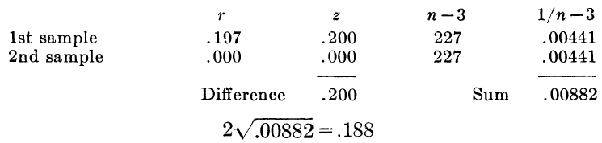
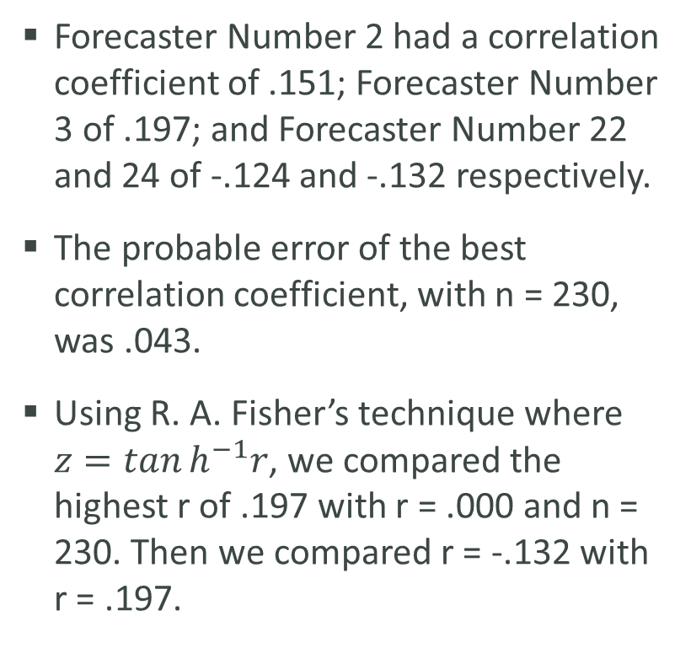
24 Financial Publications – Statistical Interpretations (cont’d)
Forecaster Number 2 had a correlation coefficient of .151; Forecaster Number 3 of .197; and Forecaster Number 22 and 24 of -.124 and -.132 respectively.
The probable error of the best correlation coefficient, with n = 230, was .043.
Using R. A. Fisher’s technique where $z=\tan{h^{−1}r}$, we compared the highest r of .197 with r = .000 and n = 230. Then we compared r = -.132 with r = .197.

Slide 21
24 Financial Publications – Statistical Interpretations (cont’d)
Since .188 is approximately equal to .200, the presumption of skill is slight but it does exist as .188 is less than .200.
When we compared the best correlation coefficient r =.197 with the worst r of -.132, it seems that there is a real difference between the two samples. If another sample were taken from each of these two forecasters, we should expect to find a similar difference between them in favor of the first forecaster within the limits of the probable error.

Slide 22
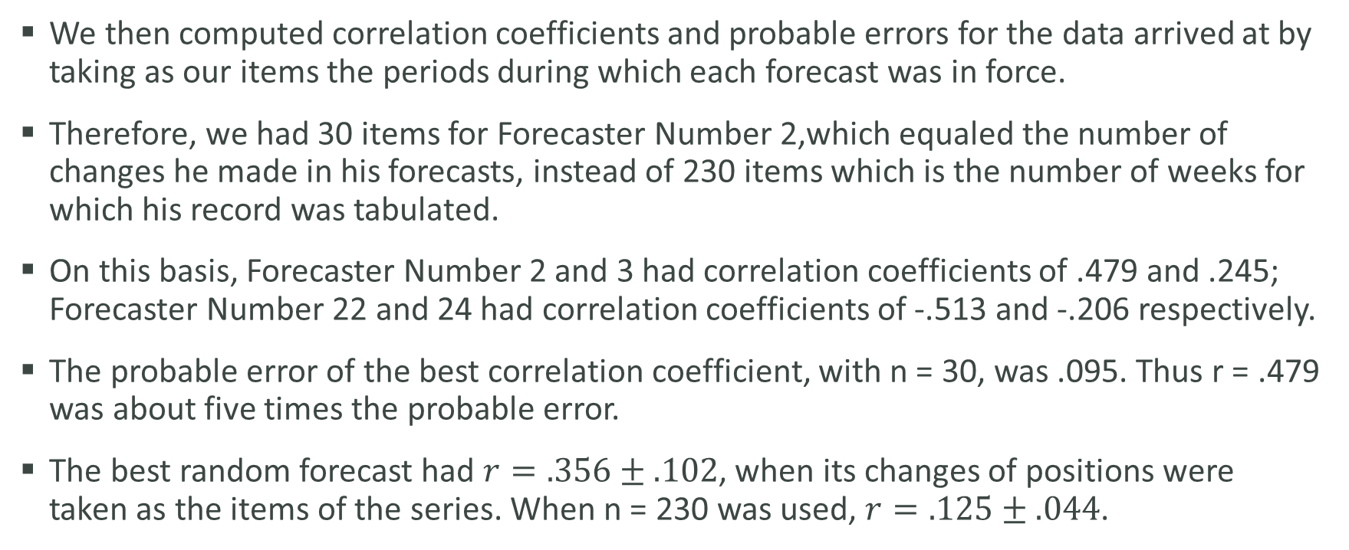
24 Financial Publications – Statistical Interpretations (cont’d)
We then computed correlation coefficients and probable errors for the data arrived at by taking as our items the periods during which each forecast was in force.
Therefore, we had 30 items for Forecaster Number 2,which equaled the number of changes he made in his forecasts, instead of 230 items which is the number of weeks for which his record was tabulated.
On this basis, Forecaster Number 2 and 3 had correlation coefficients of .479 and .245; Forecaster Number 22 and 24 had correlation coefficients of -.513 and -.206 respectively.
The probable error of the best correlation coefficient, with n = 30, was .095. Thus r = .479 was about five times the probable error.
The best random forecast had $r=.356±.102$, when its changes of positions were taken as the items of the series. When n = 230 was used, $r=.125±.044$.

Slide 23
24 Financial Publications – Statistical Interpretations (cont’d)
Deductions as to the significance of the relationships of the various correlation coefficients to the probable errors are still inconclusive.
  Inability to identify the true number of independent cases in each series.
  Not enough computations of correlation coefficients for us to determine the character of their distribution.

Slide 24
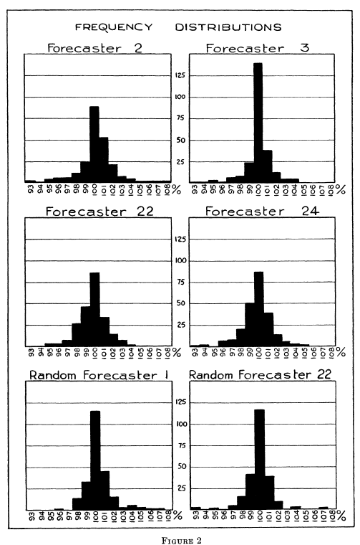
24 Financial Publications – Statistical Interpretations (cont’d)
We then measured the spread of the performances of the individual forecasters by means of frequency distributions of the percentage weekly gains and losses of each of six forecasters divided by the average result of all possible forecasts.
The six chosen were two of the best actual records, two of the worst actual records, and the best and the worst random records.
These frequencies were plotted and appeared to be reasonably normal.

Slide 25
24 Financial Publications – Statistical Interpretations (cont’d)
Averages of each of the percentage frequency distributions were computed and compared with a theoretical average of 100, which was the average of all random frequency distributions.
The probable error was .086.
Forecasters Number 2 and 3 showed averages of 100.098 and 100.103, each deviating from the theoretical average by less than twice the probable error.
Forecasters Number 22 and 24 showed averages of 99.674 and 99.711, less than the theoretical average by more than three times the probable error.

Slide 26
24 Financial Publications – Statistical Interpretations (cont’d)
When a similar frequency distribution is made for the best purely random forecaster, the average is 100.213, which is greater than that of Forecasters 2 and 3. The deviation from the theoretical average lies within three times the probable error.

Slide 27
Summary – Individual Stock Forecasts
16 financial services, who made 7,500 recommendations of individual common stocks for investment during the period from 1928 to 1932, compiled an average record that was worse than that of average common stock by 1.43% per year. Statistical tests of the best individual records were more probably results of chance other than skill.
25 fire insurance companies, who made a similar selection of securities during the years 1928 to 1931, achieved an average of 1.20% per year worse than that of the general run of stocks. The best of these records failed to exhibit the existence of any skill in investment.

Slide 28
Summary – Stock Market Forecasts
William Peter Hamilton, who forecasted the stock market based on Dow Theory from 1904 to 1929, achieved a result better than a ordinarily normal investment return, but poorer than the result of a continuous outright investment in representative common stocks for this period. On 90 occasions he announced changes in the outlook for the market, 45 of the predictions were successful and 45 were not.
24 financial publications forecasted the stock market during the 4.5 years from 1928 to 1932, failed as a group by 4% per year to achieve result as good as the average of all purely random performances. Various statistical tests of these 24 forecasters indicates that the most successful records are little better than the result from pure chance. However, the least successful records are worse than the result from pure chance.

Slide 29
My Thoughts
Provided some insights into the market efficiency theory.
However, the author did not provide any explanation for those results.
Some of the assumptions in the methods are debatable.

Slide 30
Any Questions?

Slide 31
Thank You!

